Slide 1

Notes:
--- # Feedback

Slide 2


Slide 3
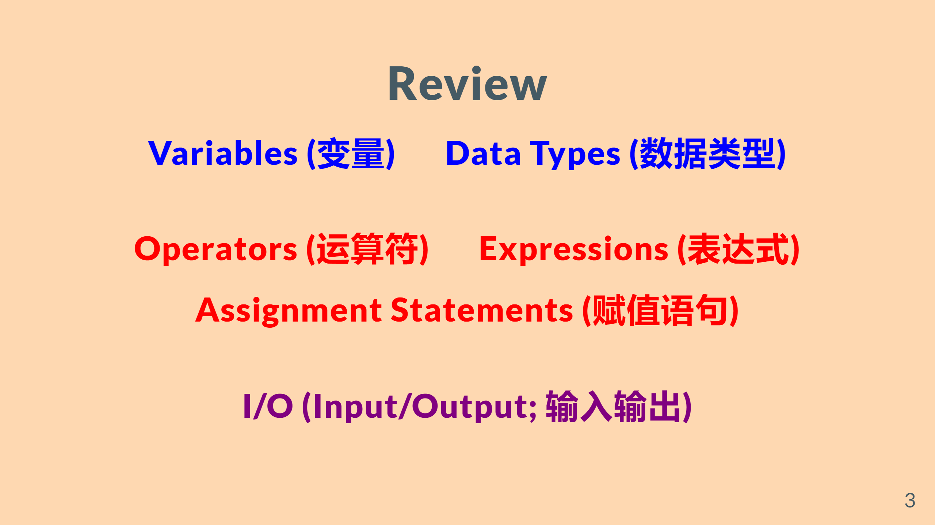

Slide 4
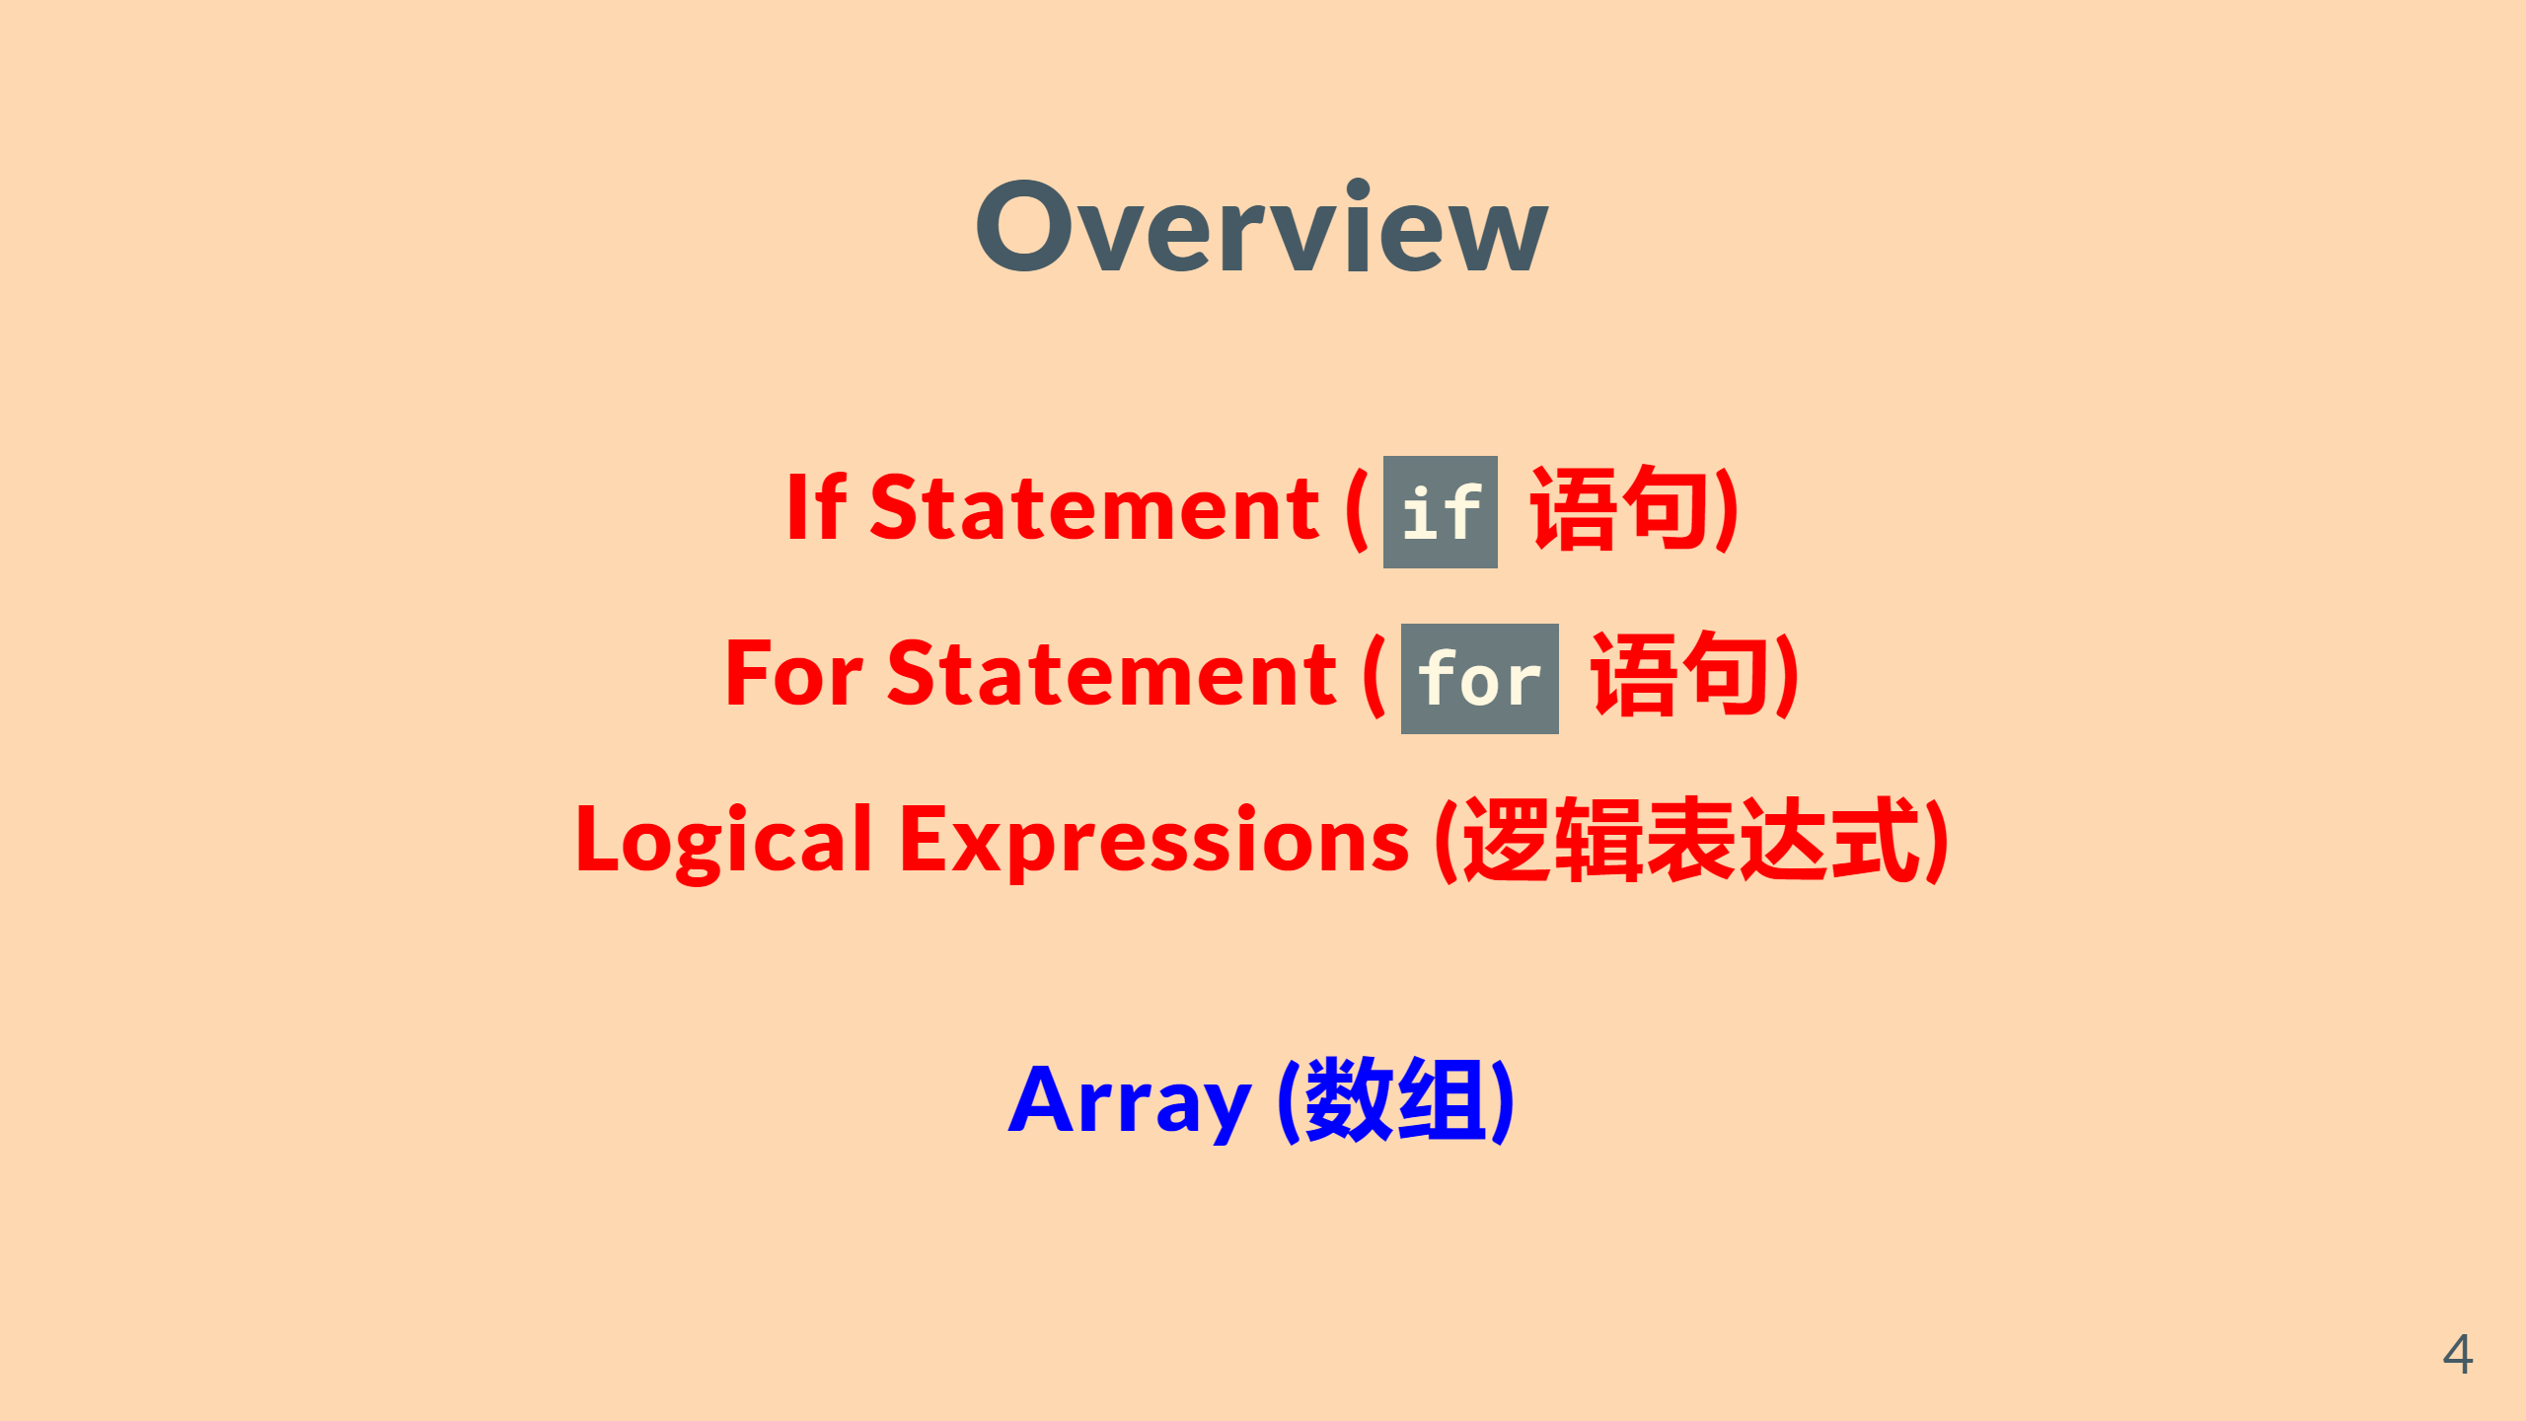

Slide 5


Slide 6
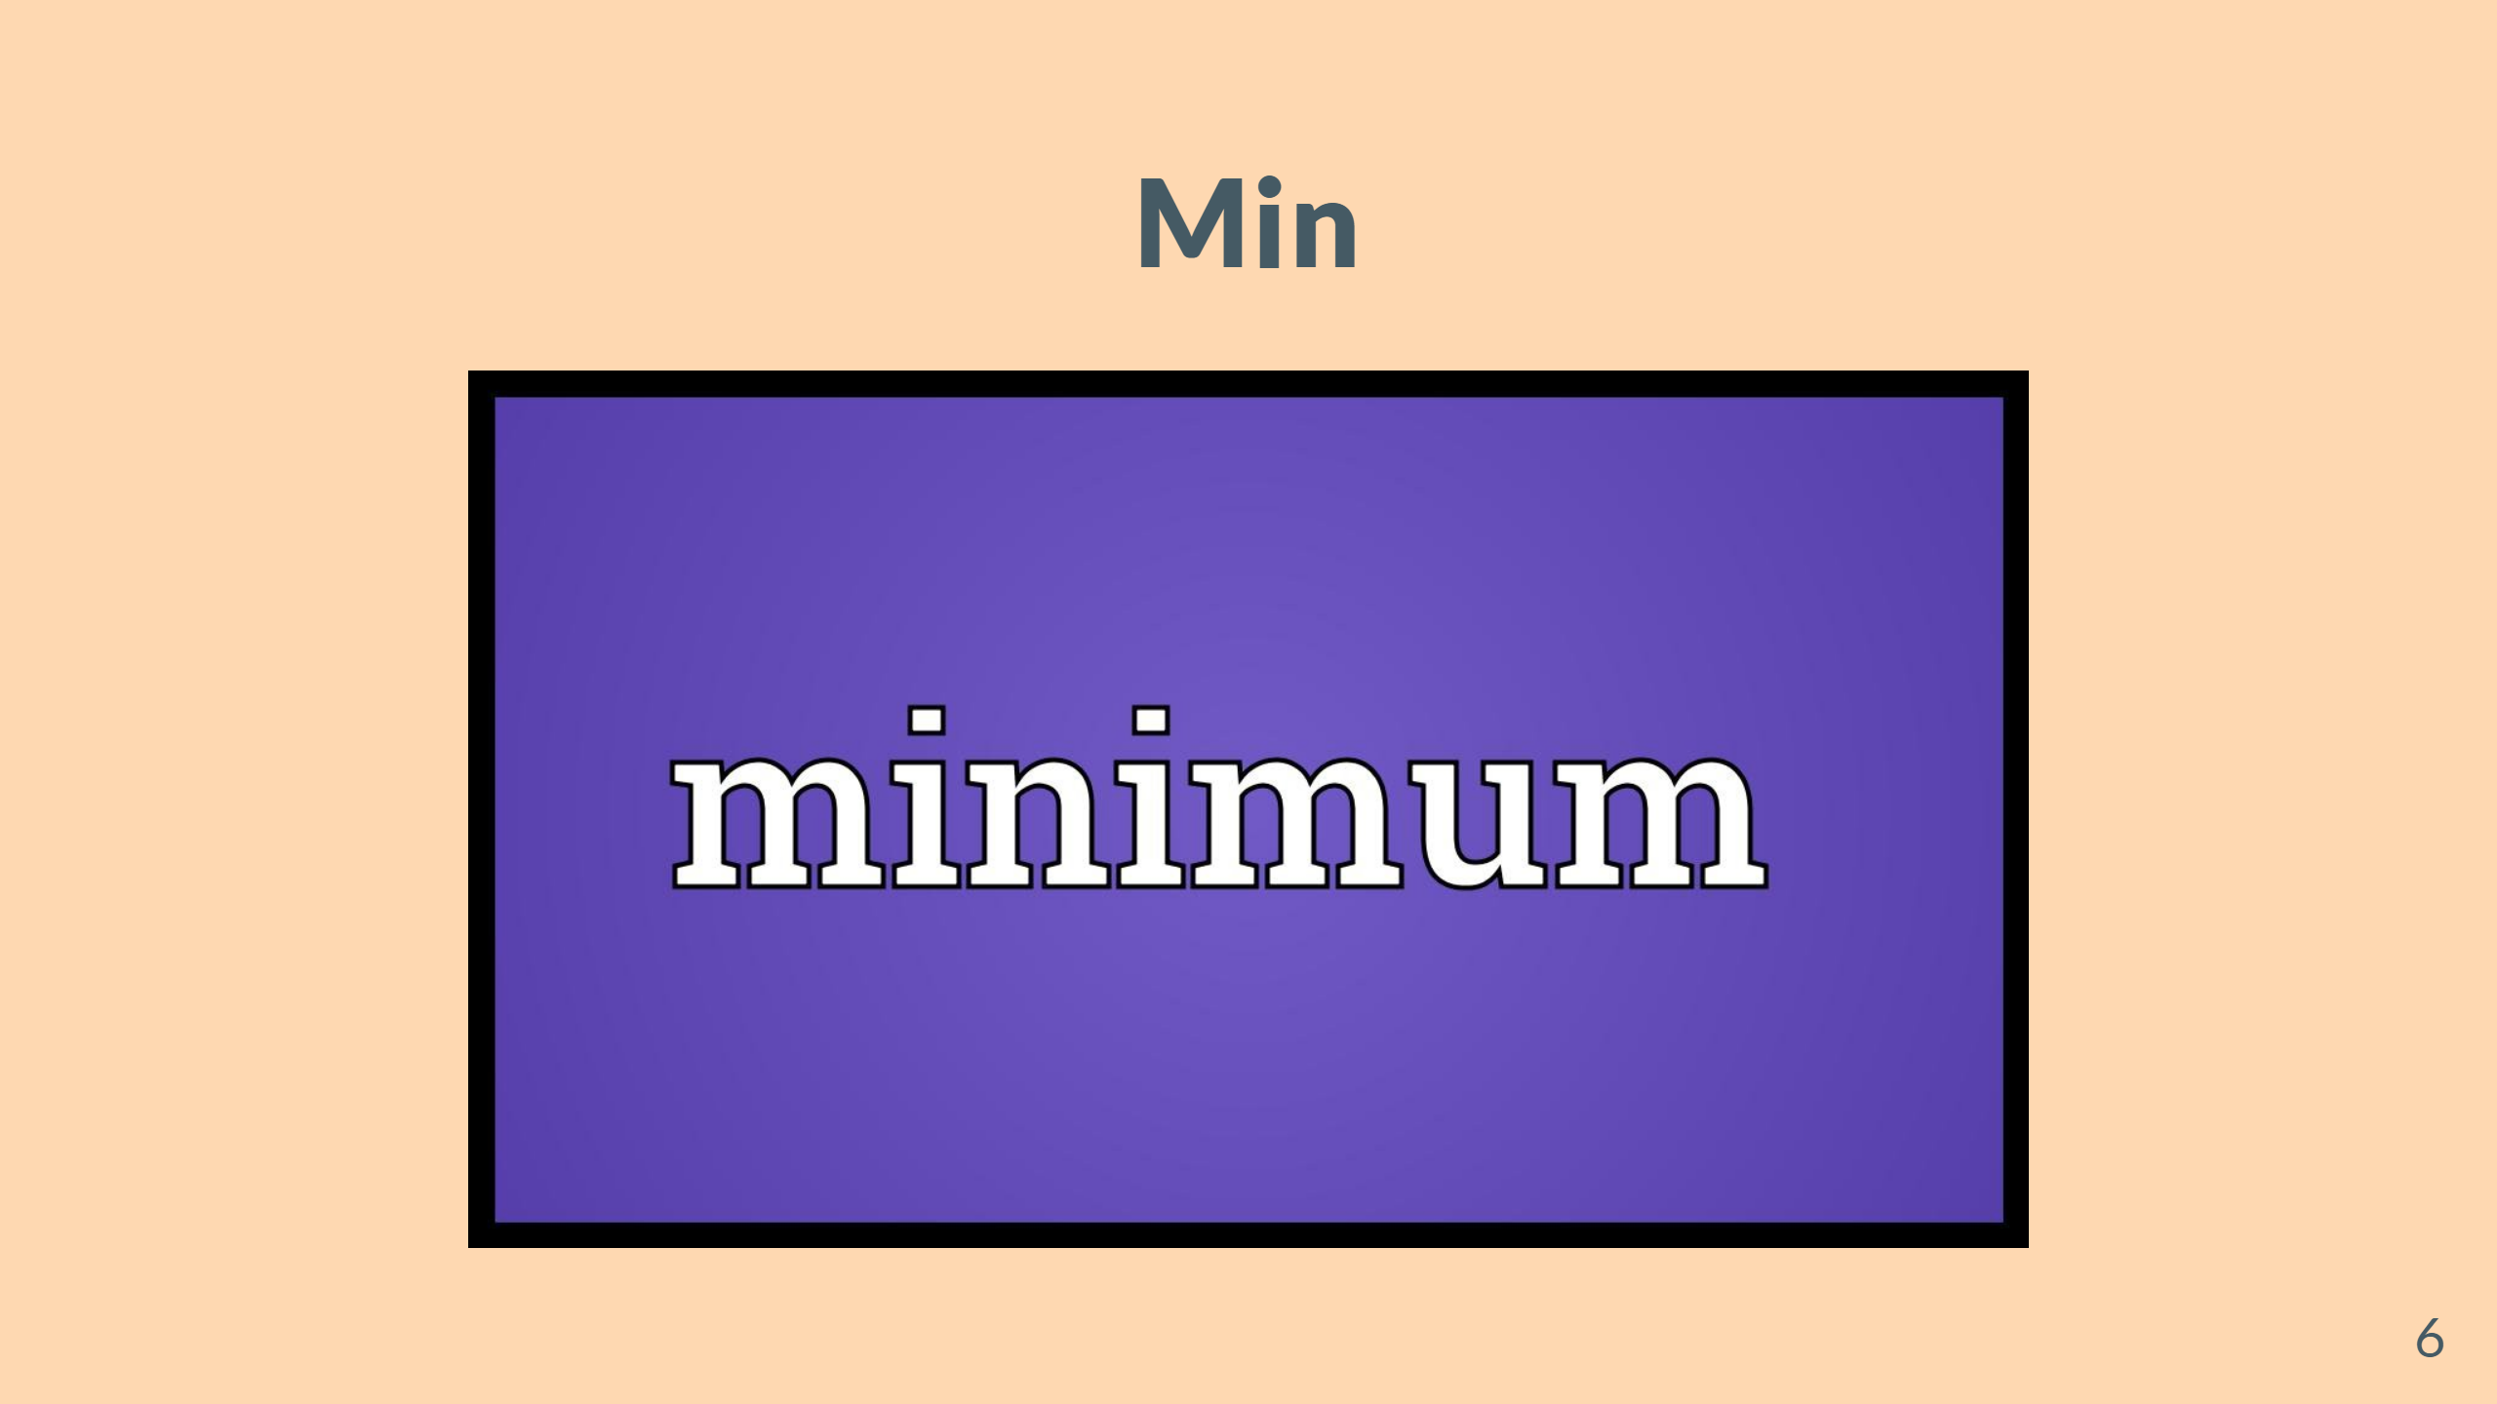

Slide 7
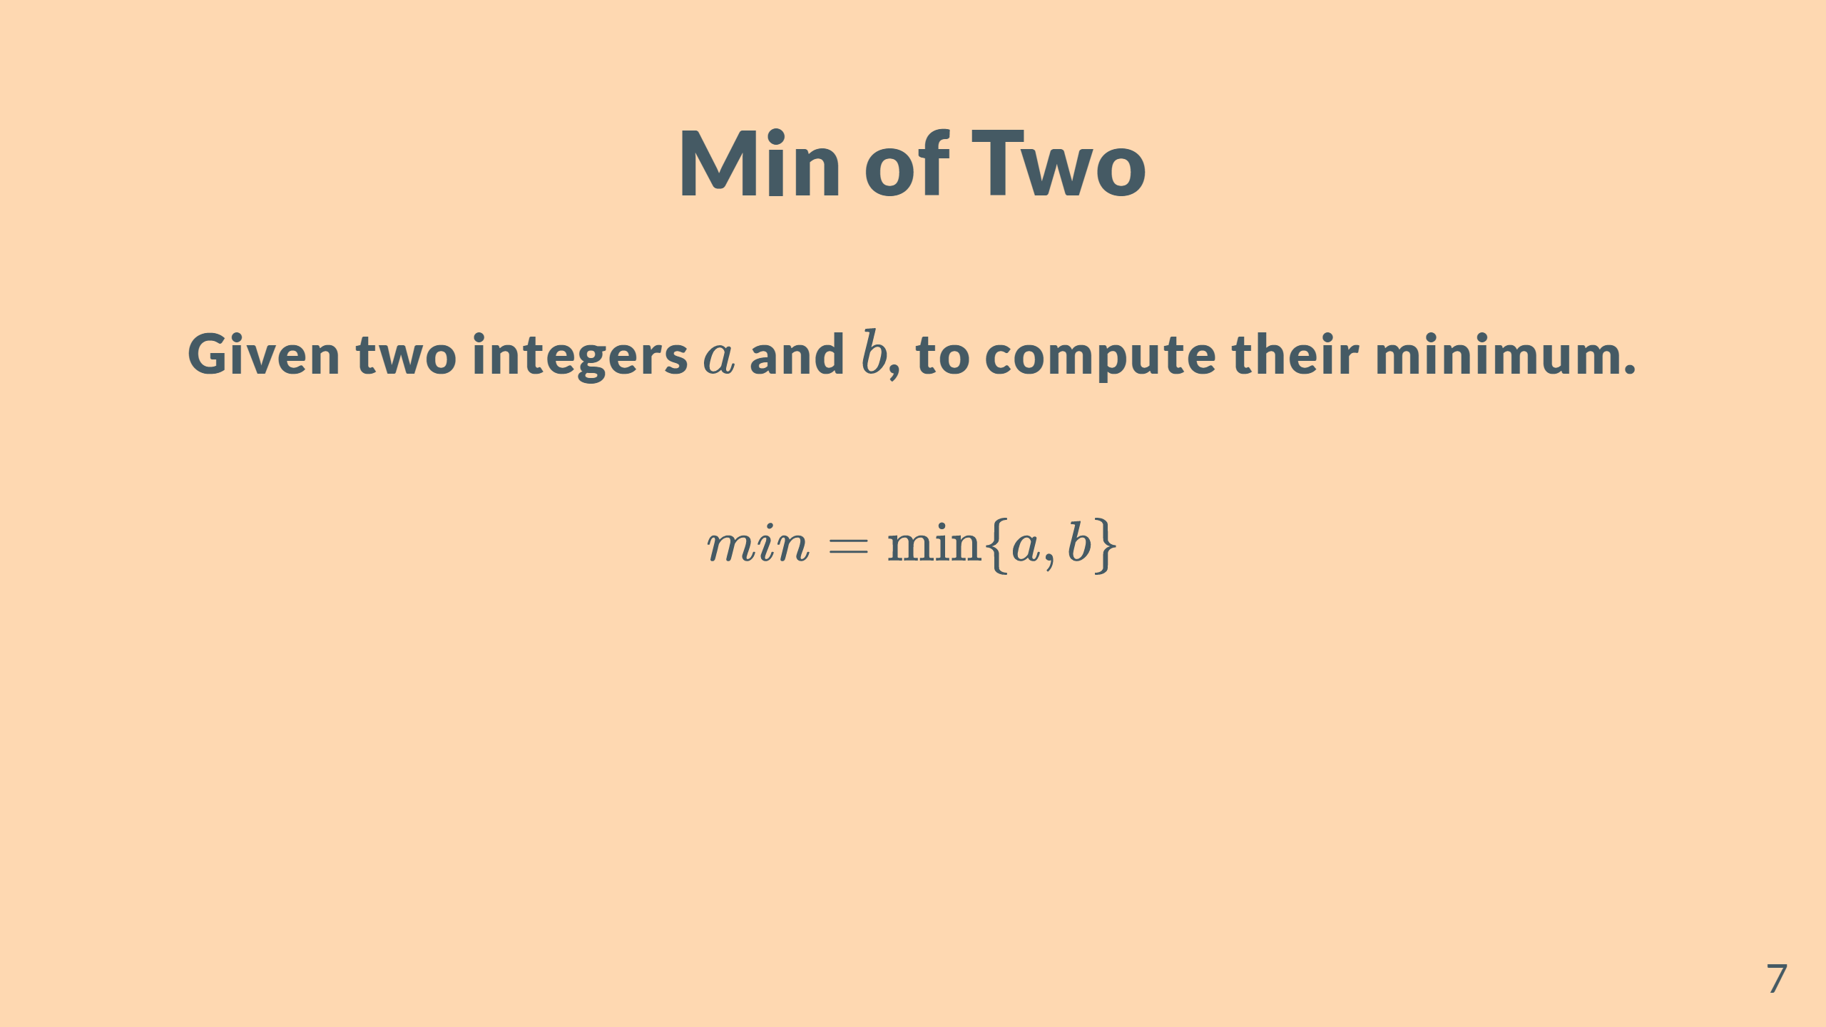

Slide 8
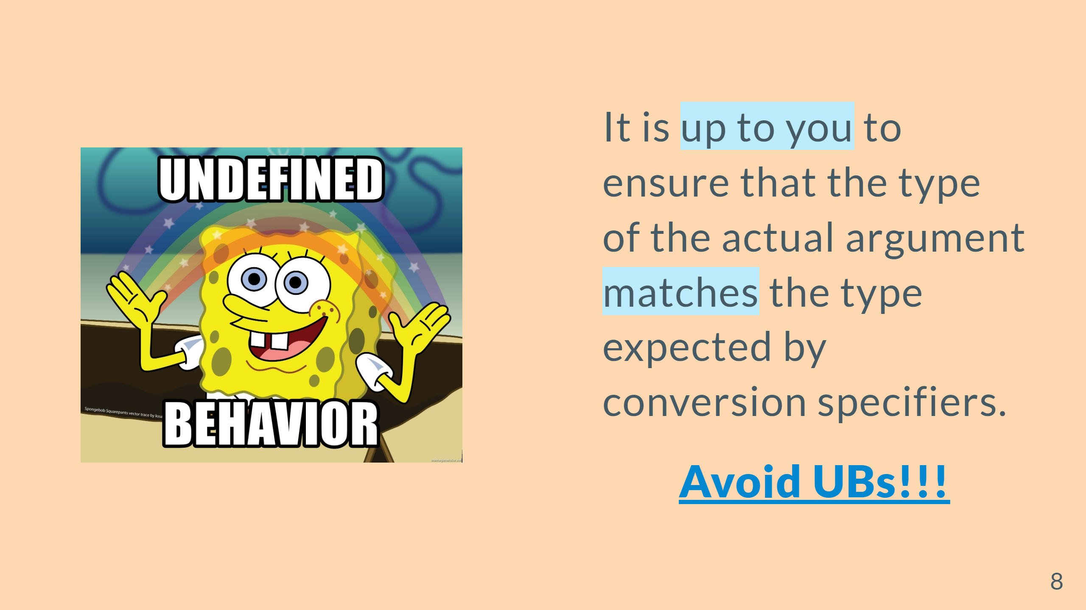

Slide 9
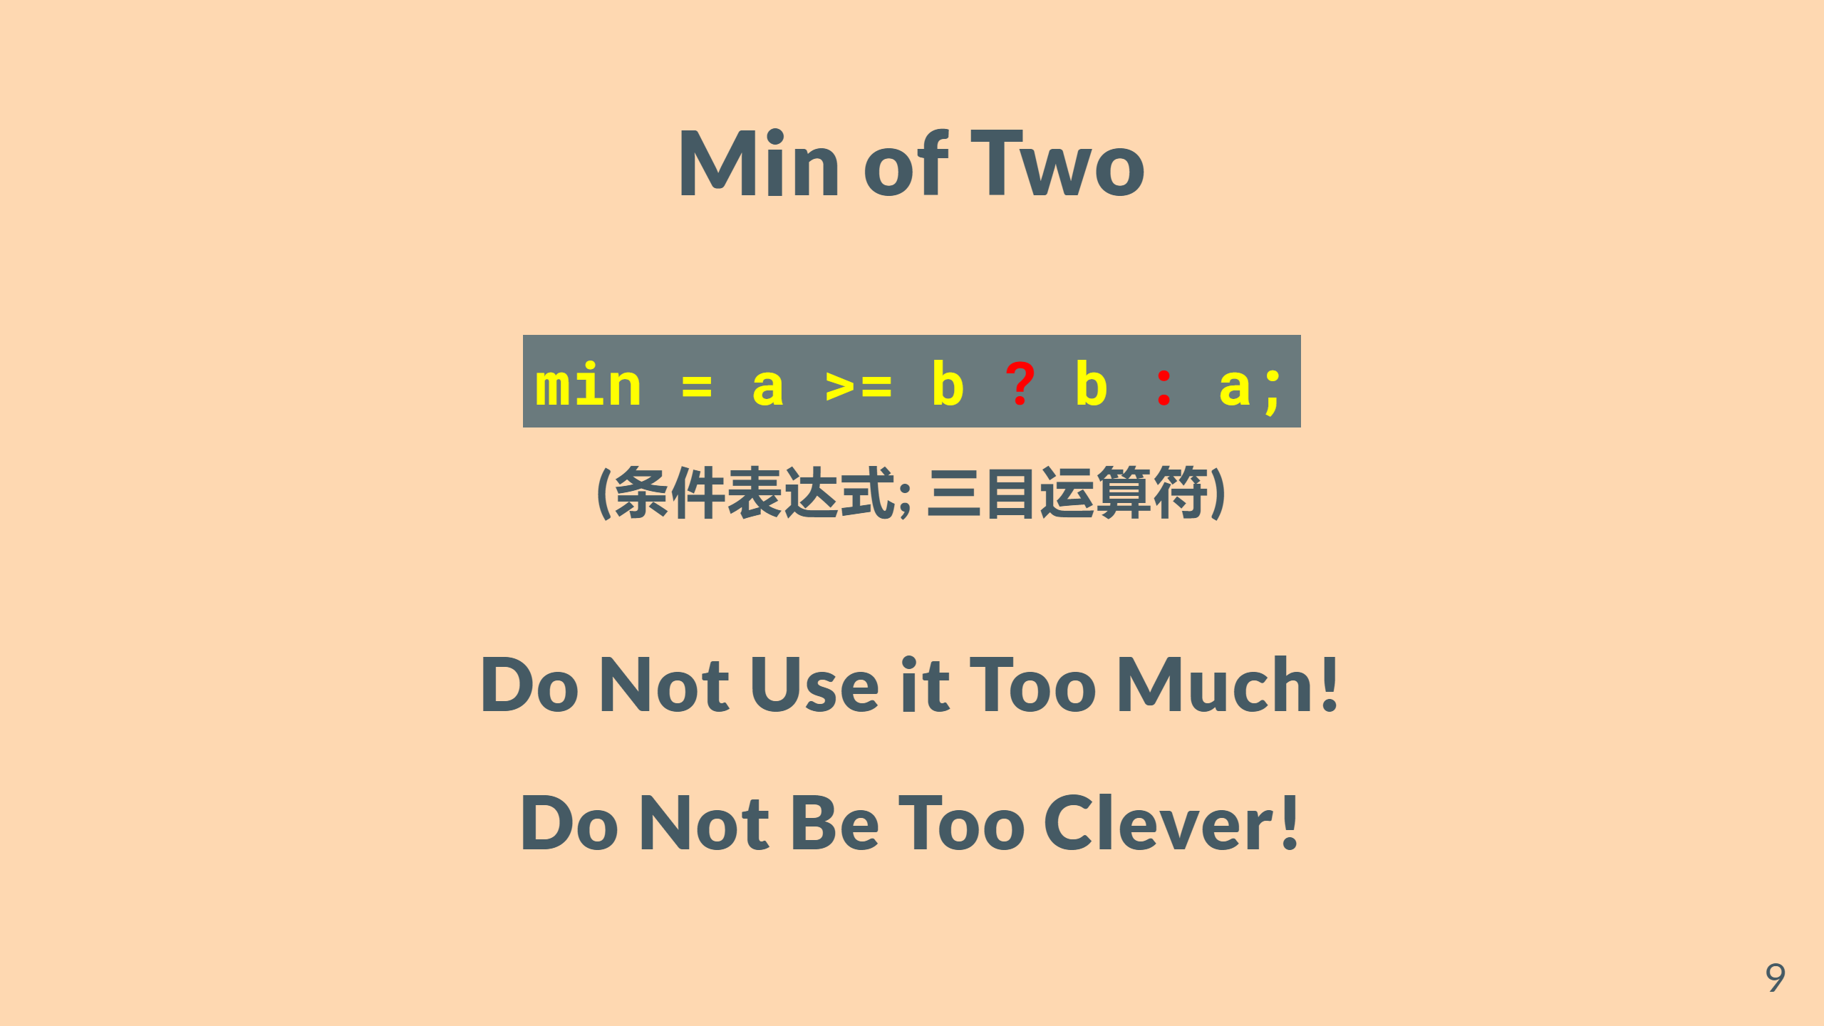
Notes:
--- # Min of Two <br> Given two <font color = red size = 8>double</font>s $a$ and $b$, to compute their minimum. <br> $\mathit{min} = \min\{a, b\}$

Slide 10
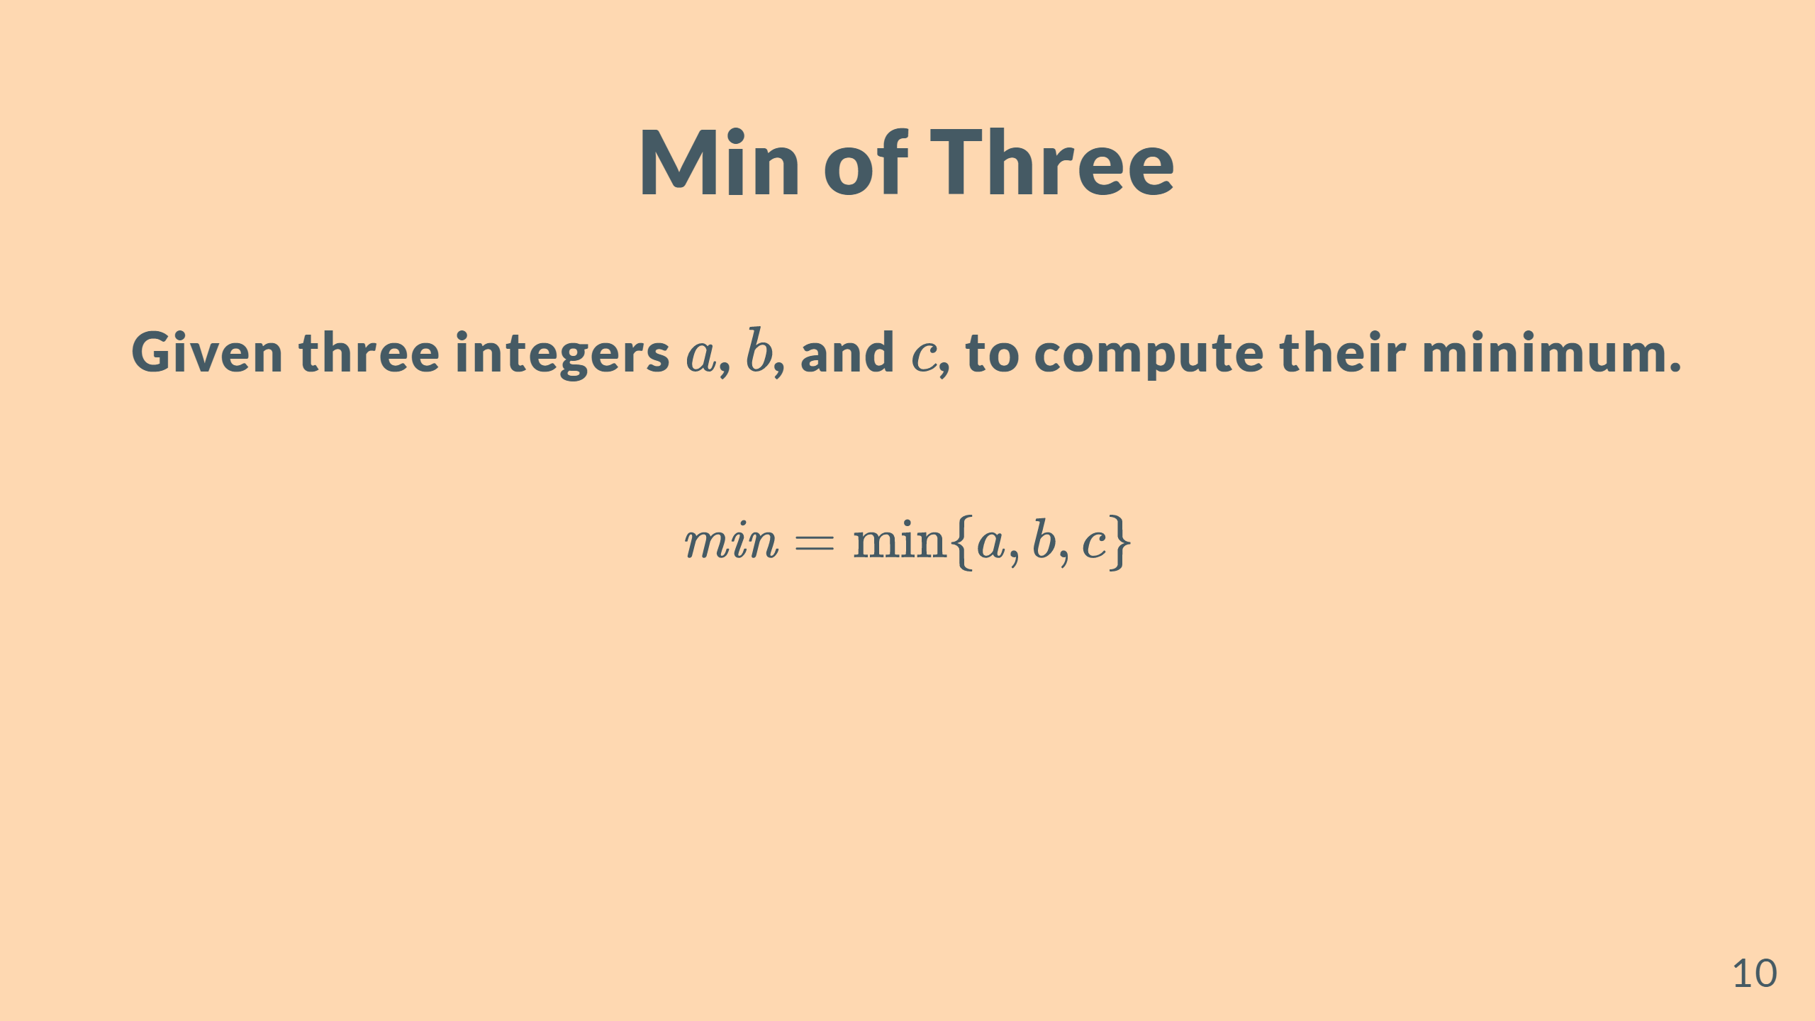

Slide 11
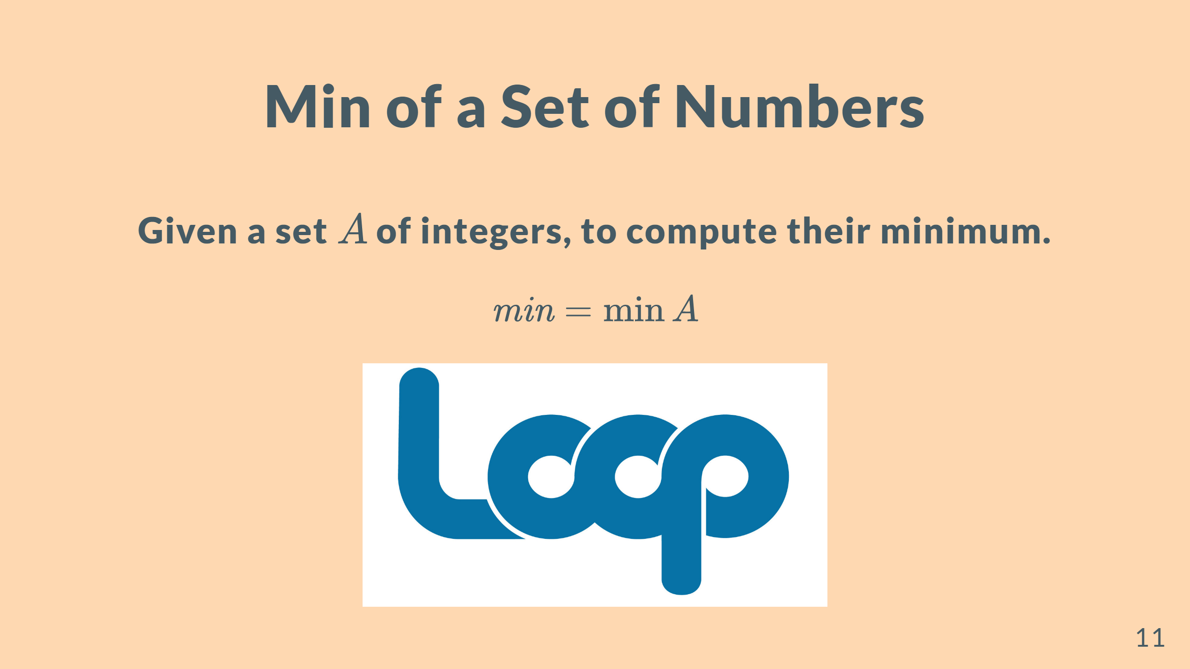

Slide 12
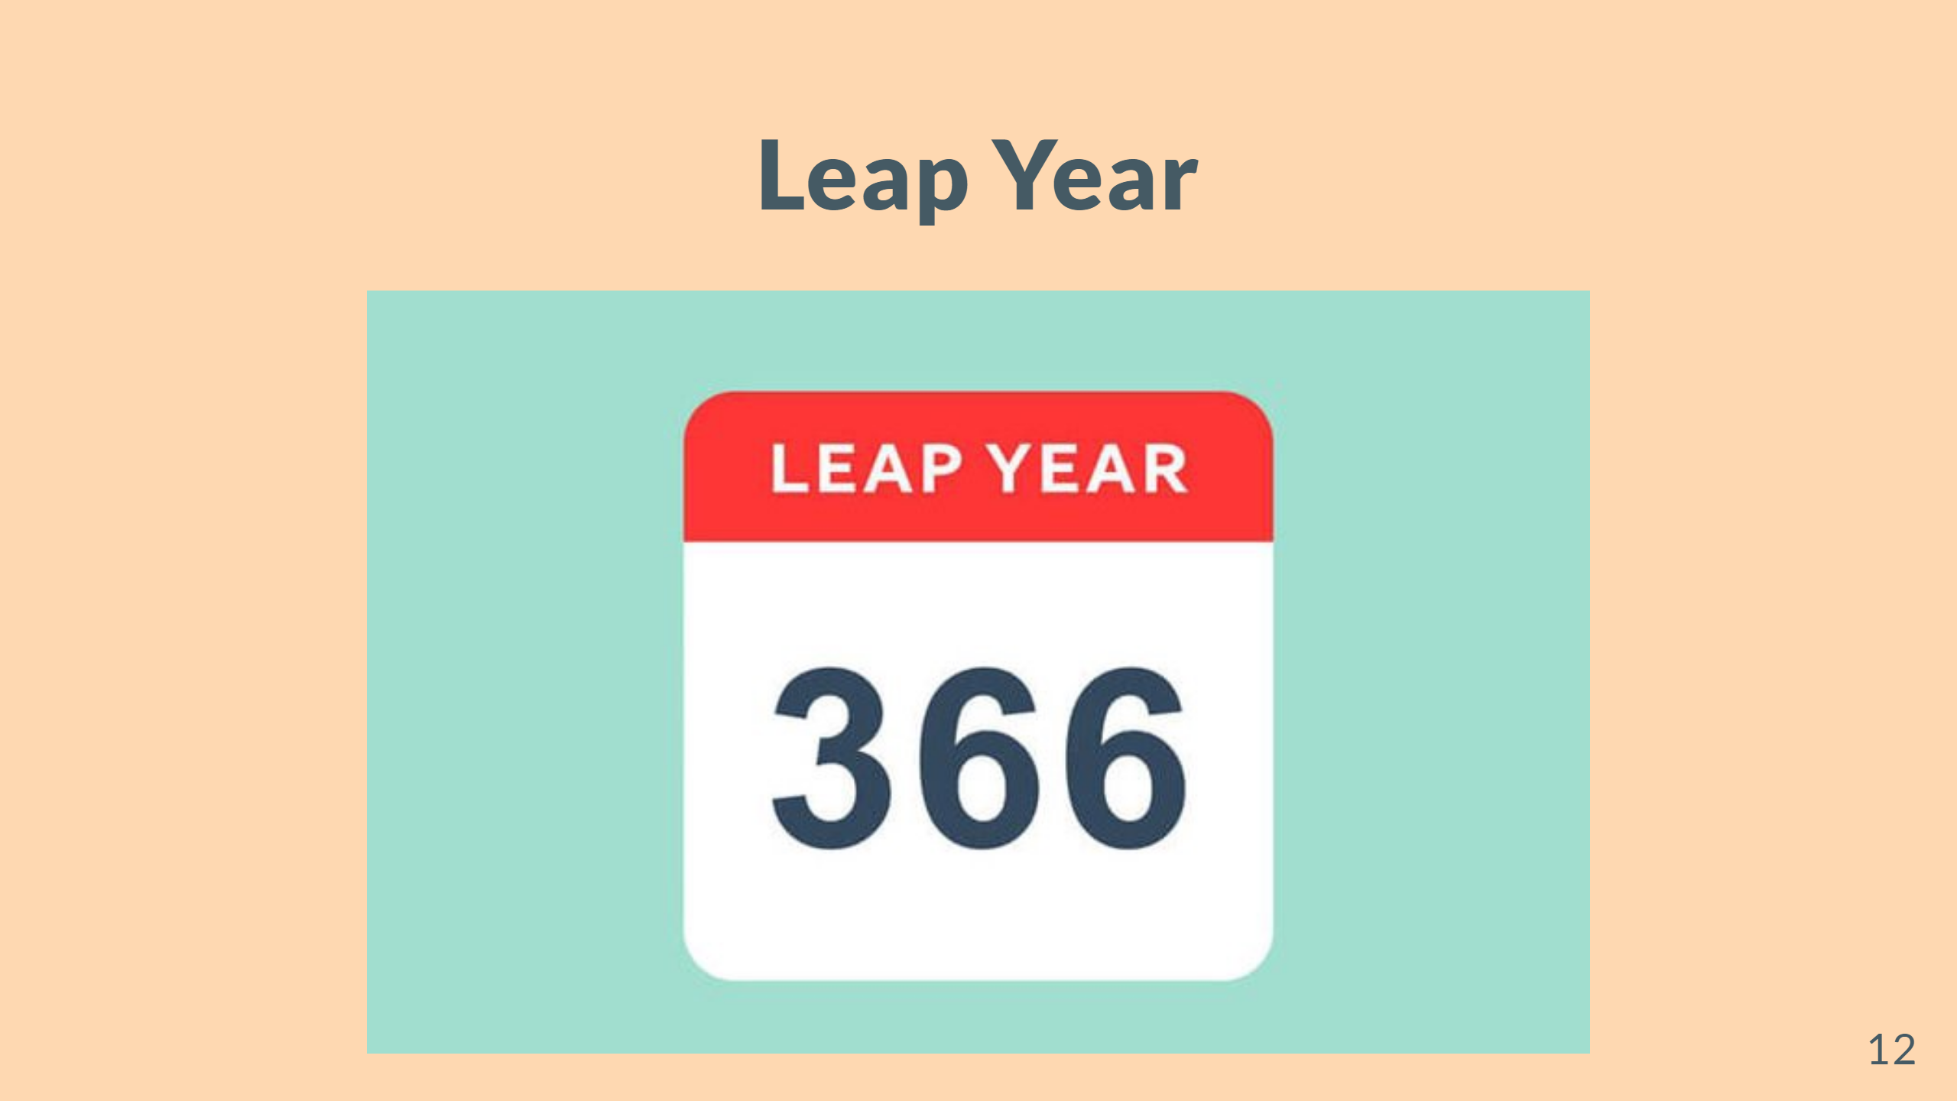

Slide 13
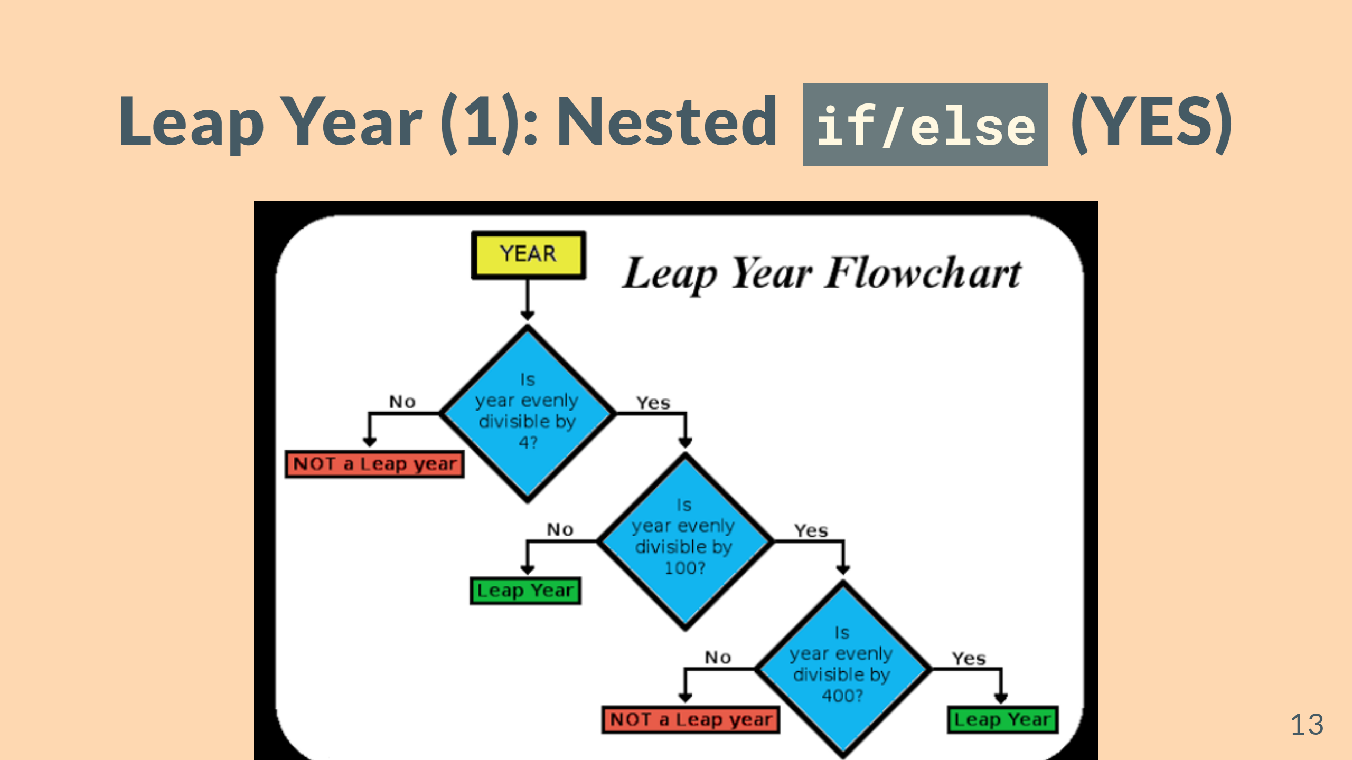

Slide 14


Slide 15
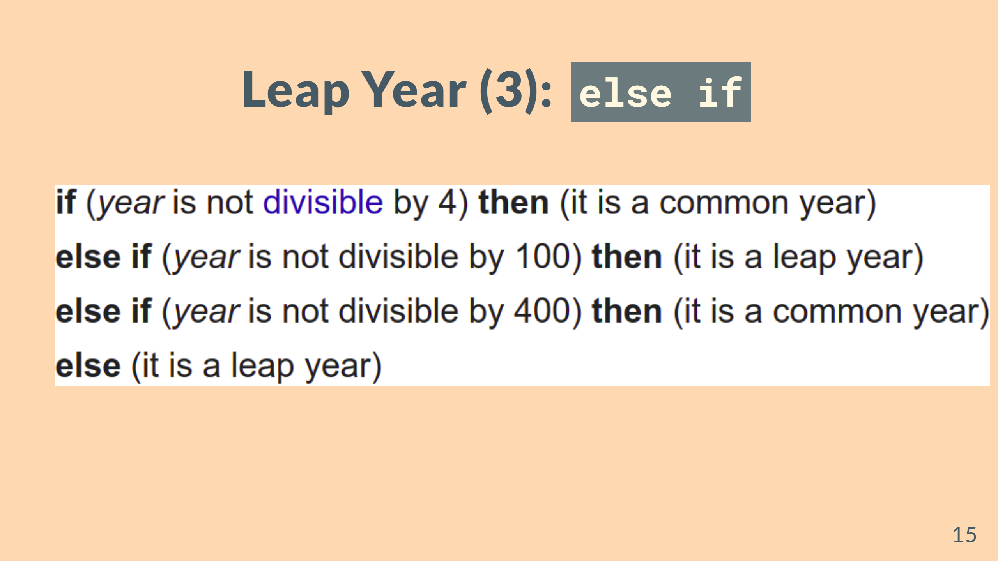

Slide 16
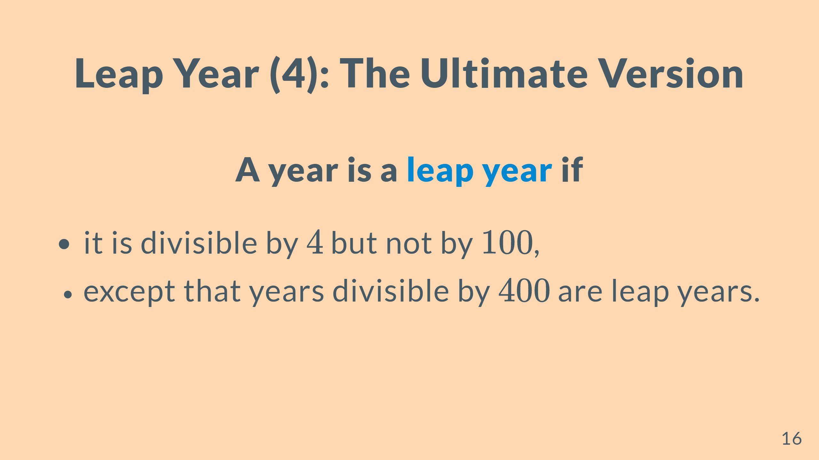

Slide 17
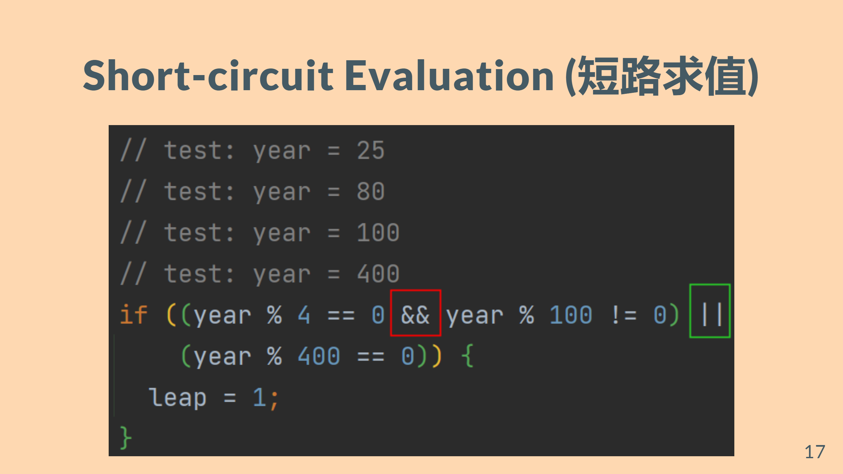
Notes:
--- # Sum Given an integer $n \ge 0$, to compute $\sum\limits_{i = 1}^{n} i$. $\sum\limits_{i=1}^{n} = \frac{n(n-1)}{2}$ ![w:250](figs/sum.jpg)

Slide 18
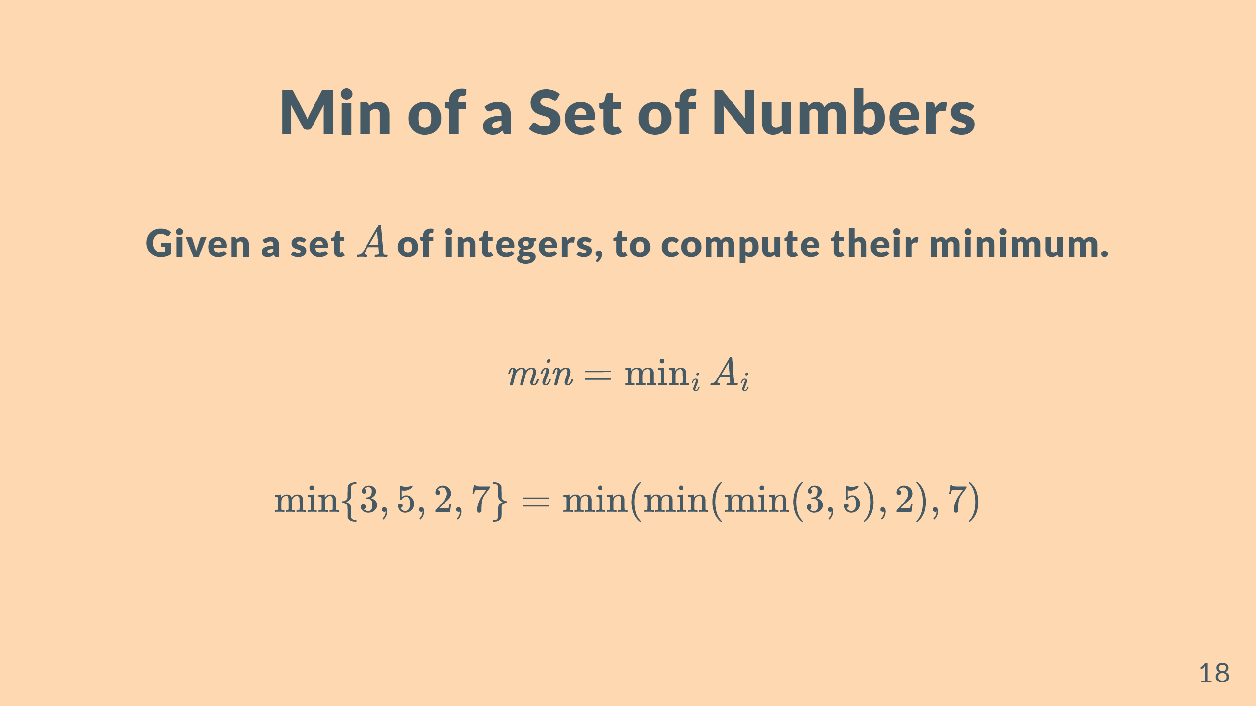

Slide 19
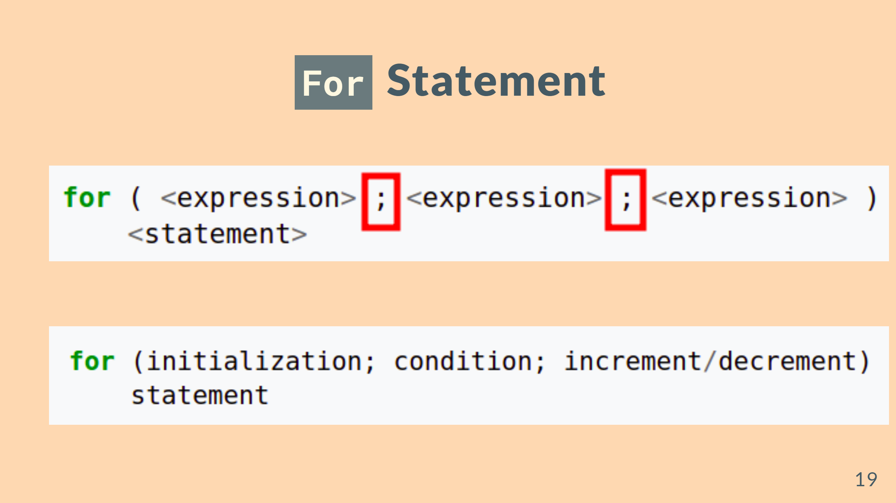
Notes:
--- # <!--fit

Slide 20
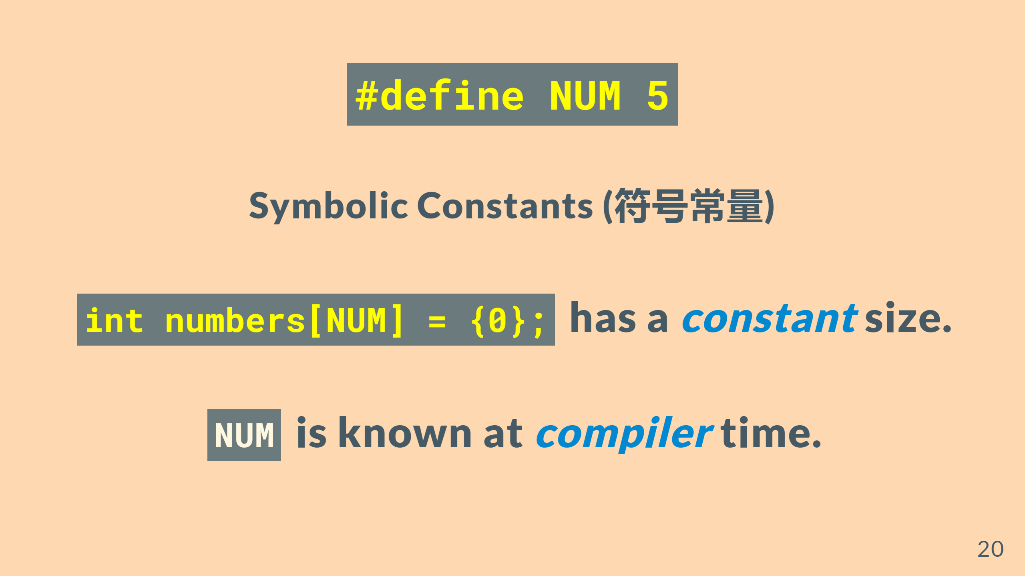

Slide 21
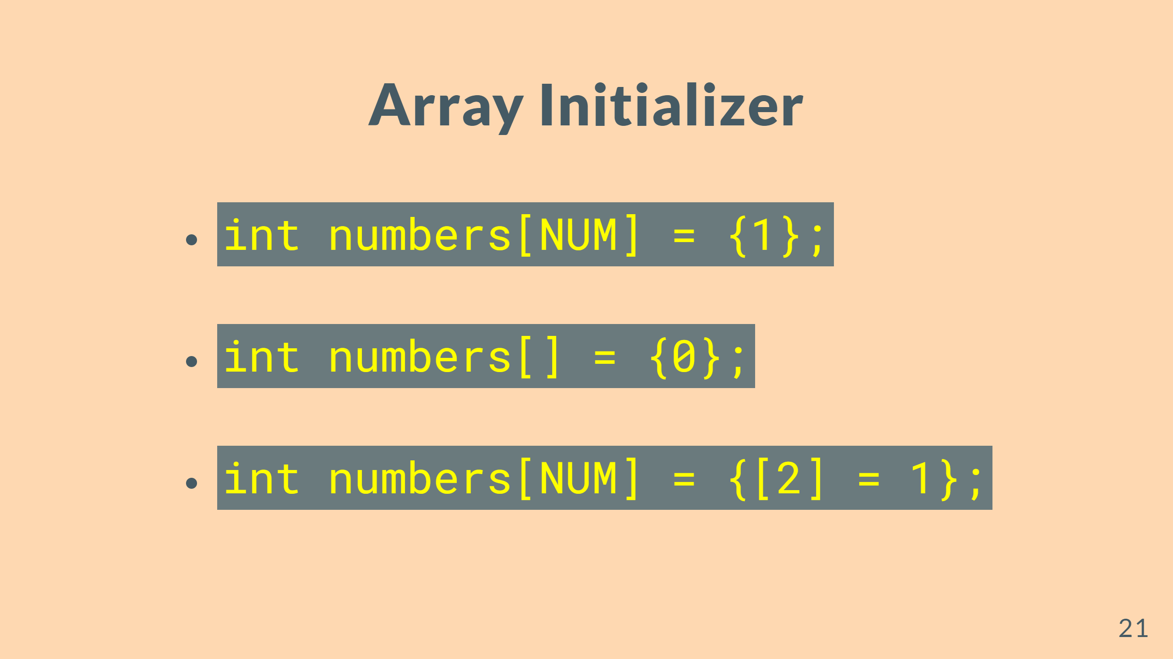

Slide 22
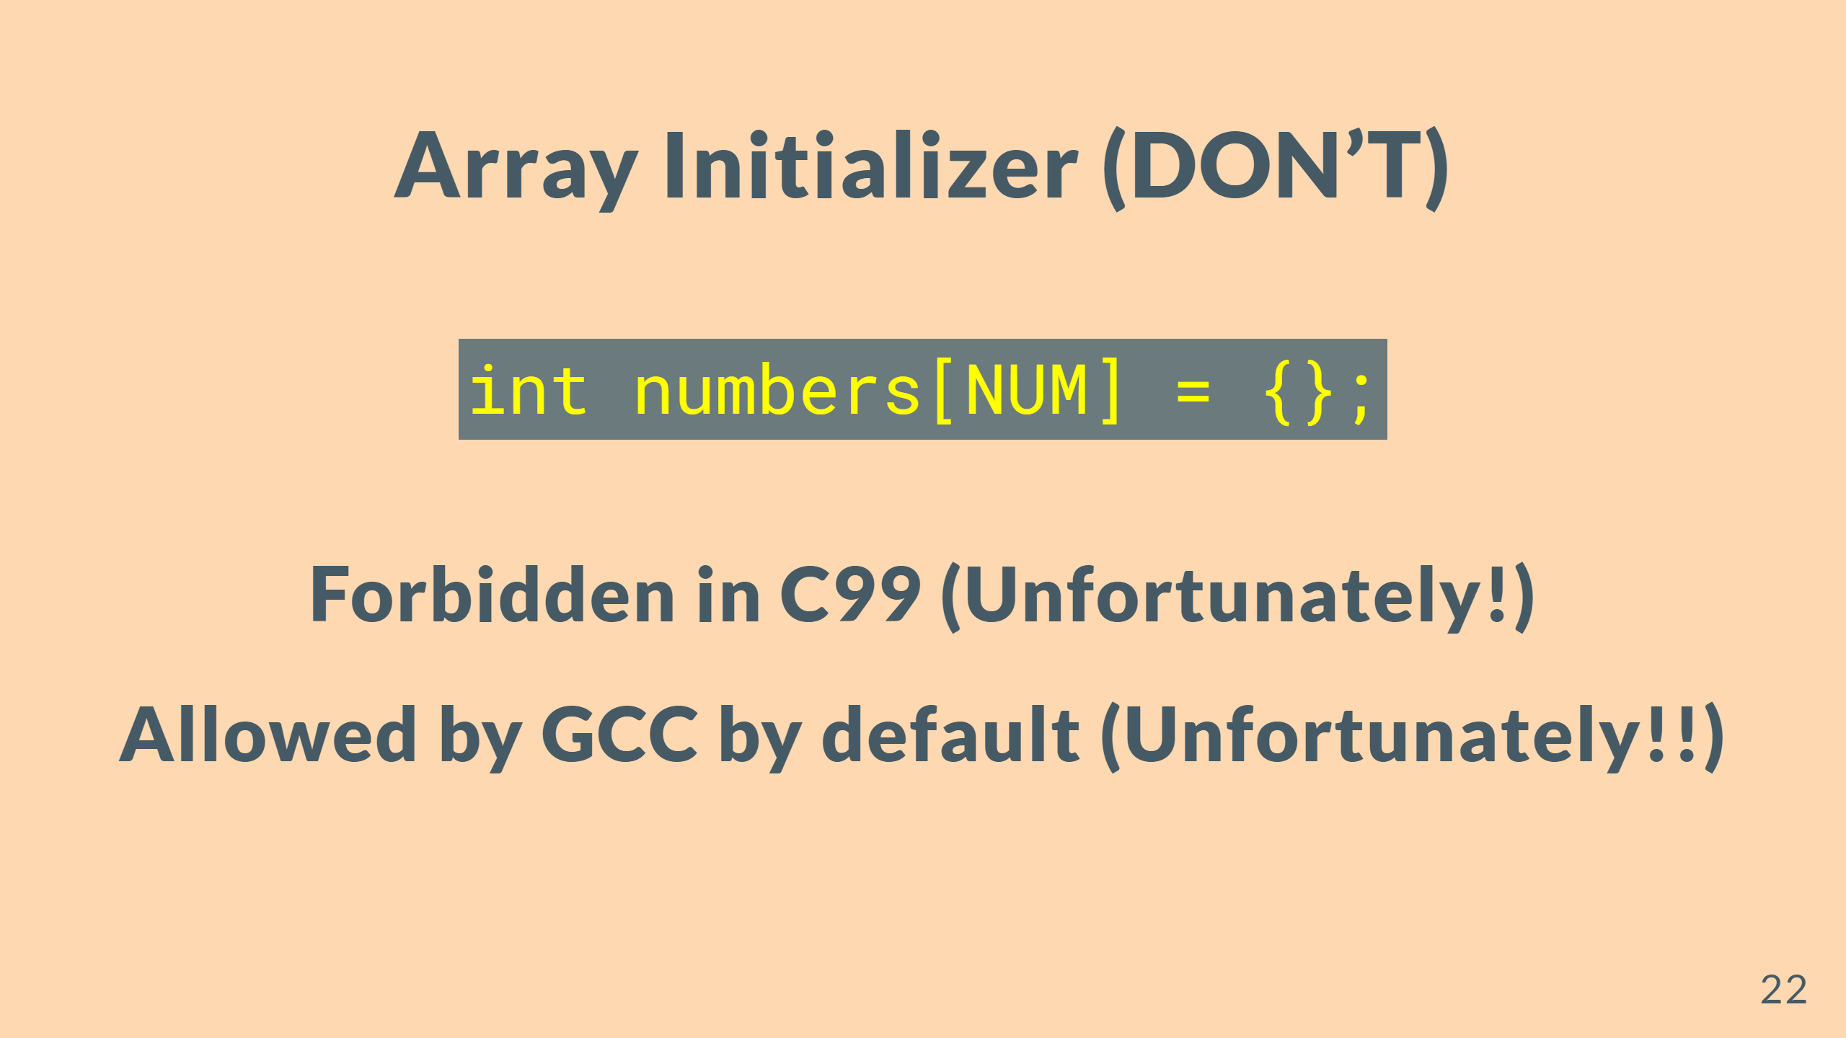

Slide 23
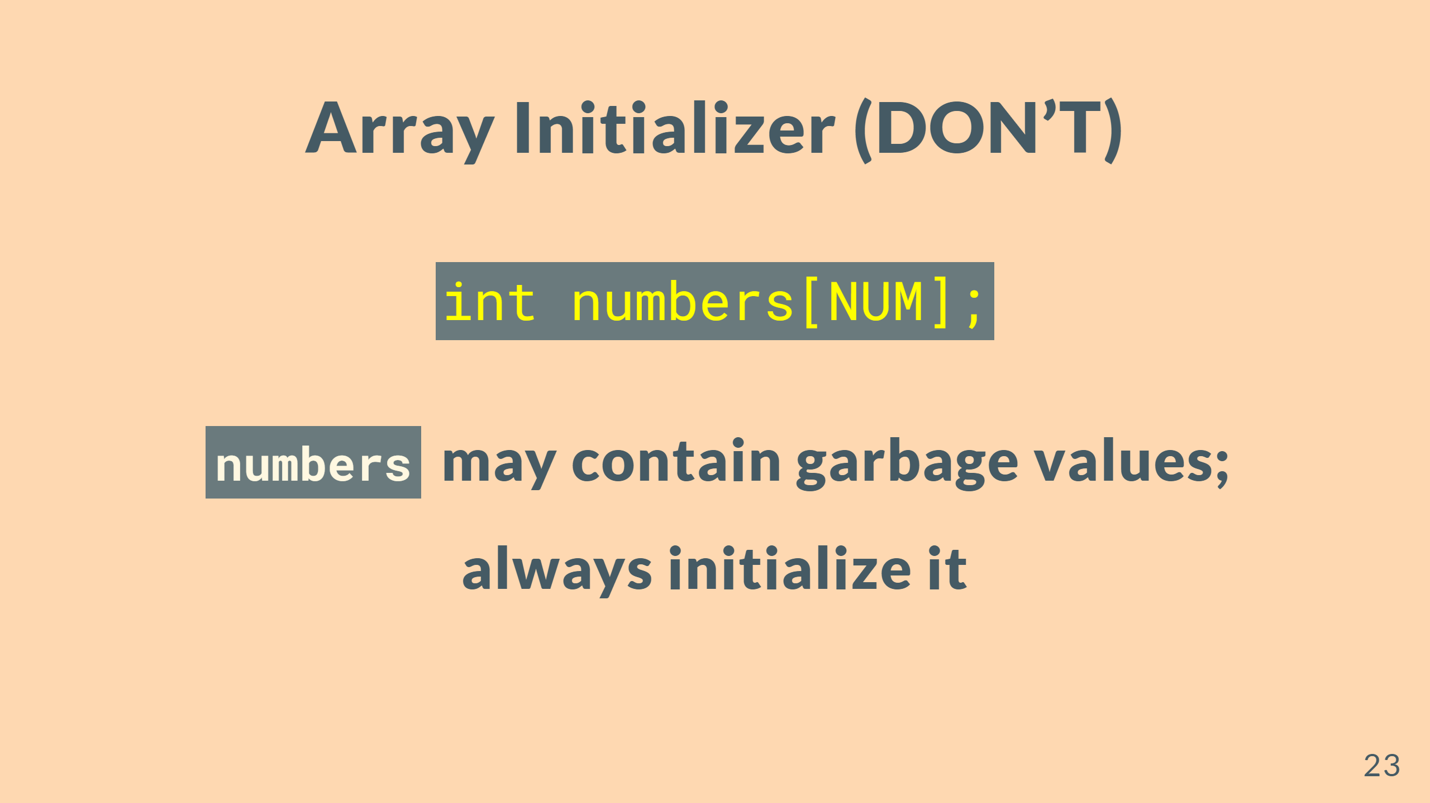

Slide 24
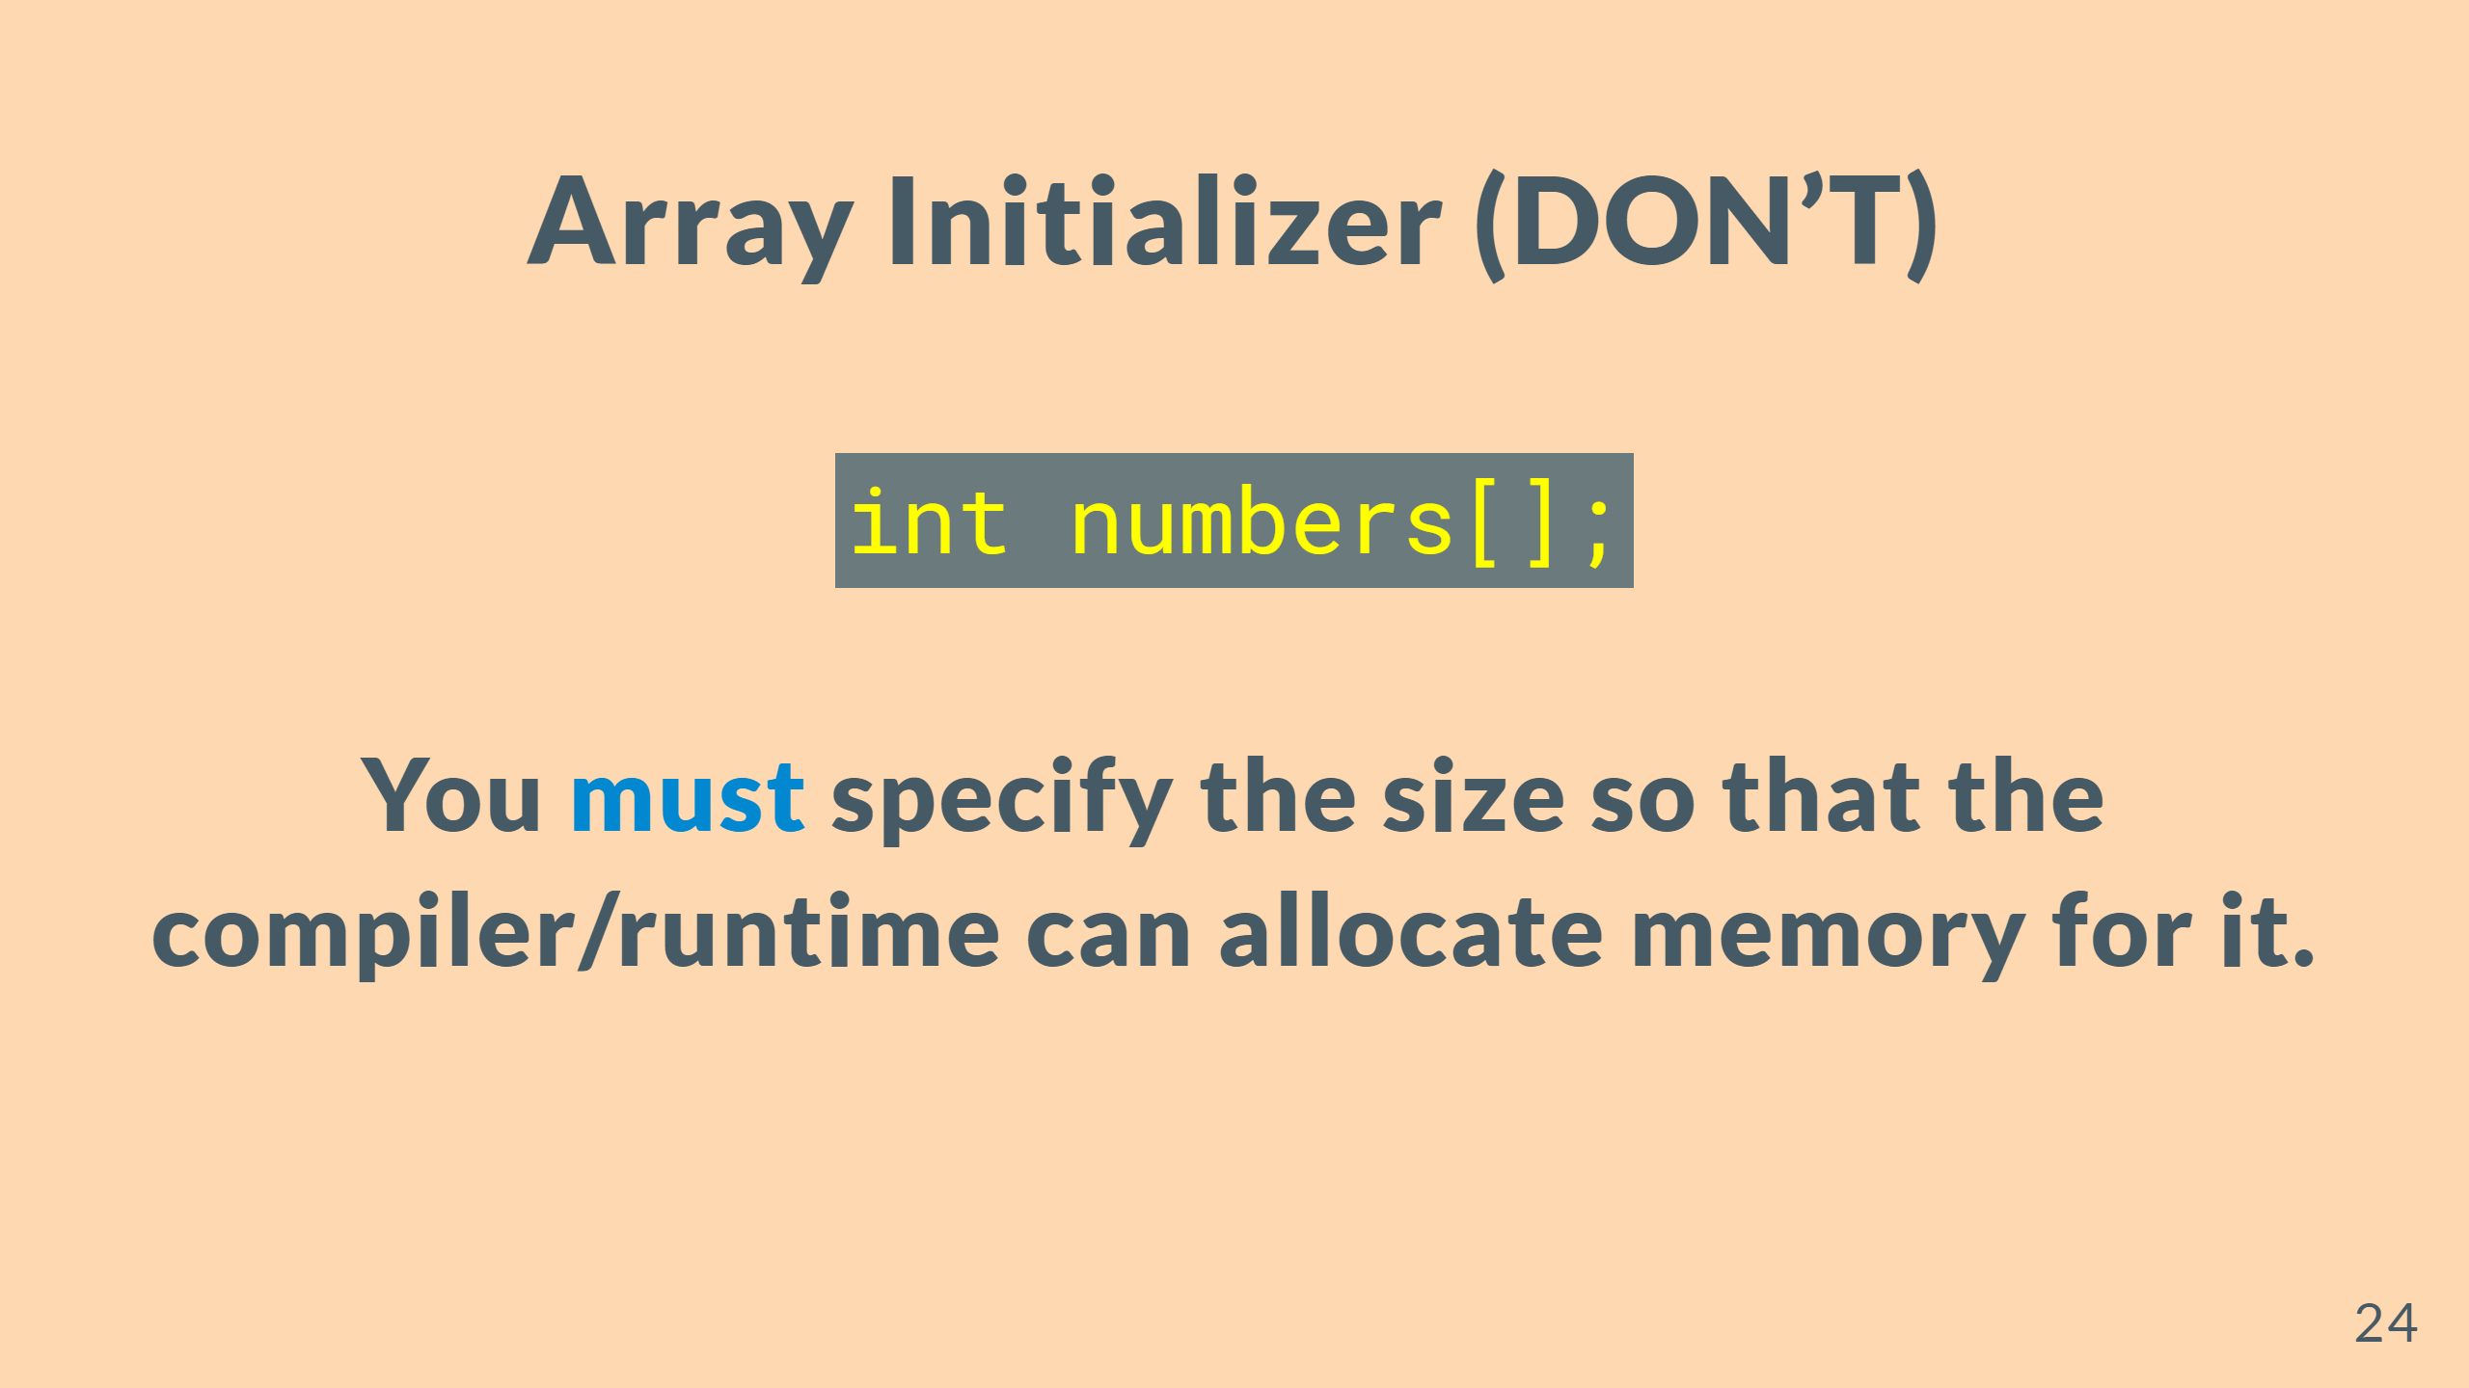

Slide 25
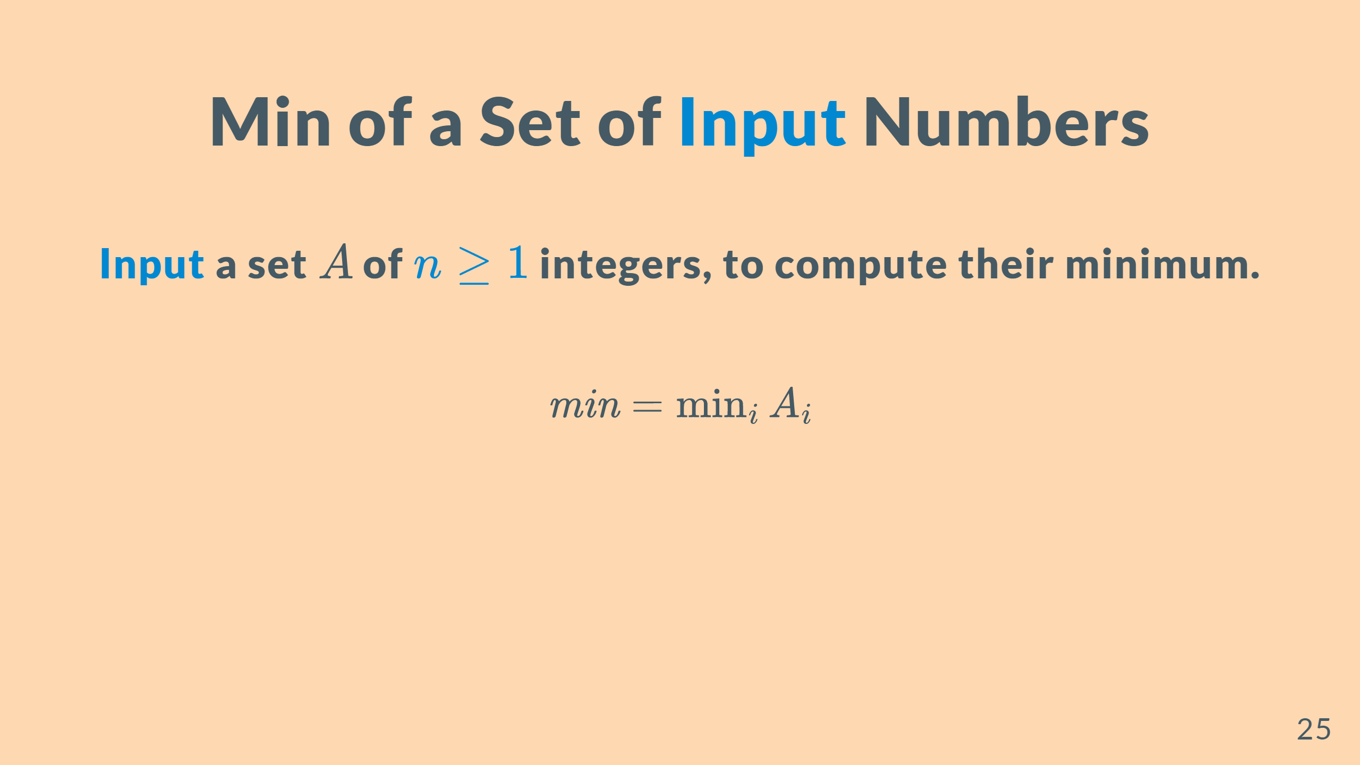

Slide 26


